Slide 1

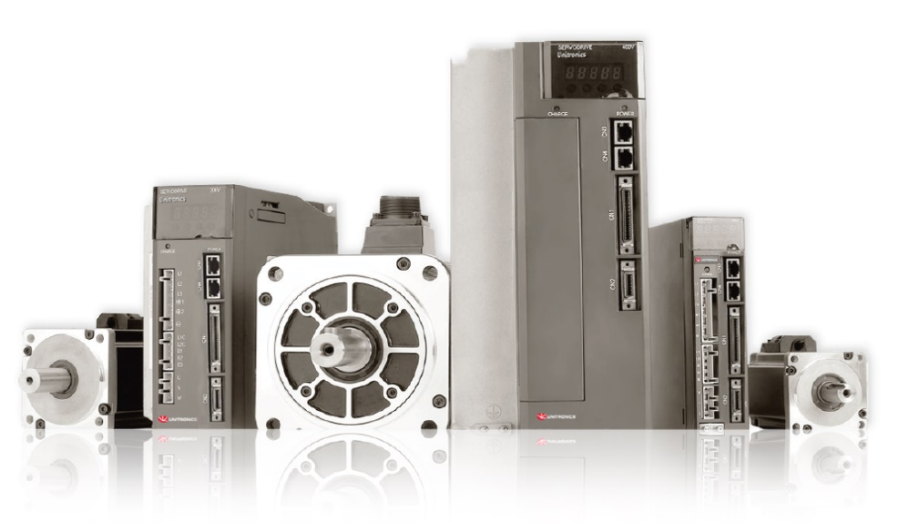
One Integrated Solution for Control & Automation:
AC Servo: Drives & Motors

Slide 2
Expanding Our Product Range
Unitronics continues to innovate and expand our product range to provide
“One Integrated Solution for Control & Automation”
These already include:
  A Complete Range of PLC+HMI
  Stand alone PLCs
  Full Range of VFDs
  All-In-One Programming Software
  Total Solution for Industry 4.0

Slide 3
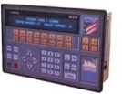
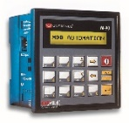


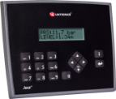
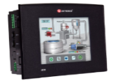
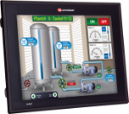
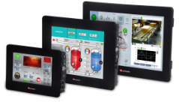
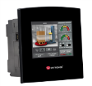
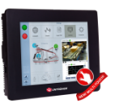


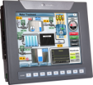
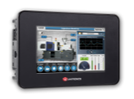

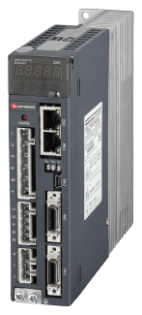
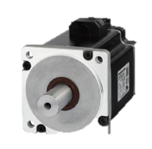
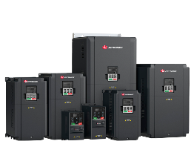
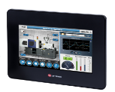
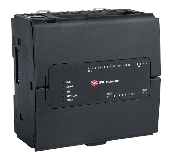
Products Time Line
1989
2000
2002
2005
2006
2011
2013
2014
2017
First
PLC+HMI
M310
Vision
Standard
Vision
Enhance
First big HMI
V1040, V1210
Unistream
launch
Samba
launch
UniStream5 built-in + Multi-Touch
M90
JAZZ
2018
2019
We are now adding
Servo Motion Control
products to these capabilities
UniStream 7” Built-in
VFD Line
UniStream PLC

Slide 4
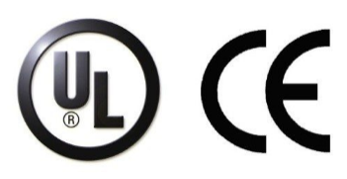
Product Offering
A bundle that includes:
Drives:
1-Phase 200-230V: 50W - 1kW (0.06 - 1.34HP)
3-Phase 200-230V: 750w - 5kW (1.01- 6.7HP)
3-Phase 380-440V: 1kW - 5kW (1.34 - 6.7HP)
Motors:
Holding Brake – Optional
Built-in Encoder
  23bit – Absolute
  20bit – incremental
Inventory:
Samples availability for all products
High availability for key products
Available soon:
  EtherCAT
  STO

Slide 5
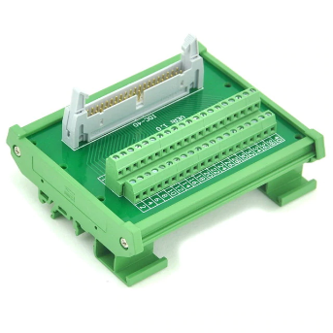
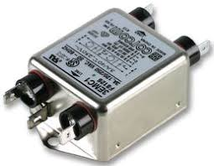
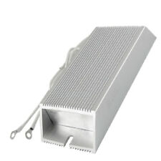
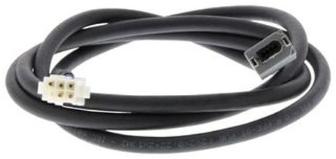
Product Offering
Accessories:
  IO Terminal block
  Filters
  Breaking resistors
  Cables - 3m, 5m, & 10m
    *standard and robotics

Slide 6
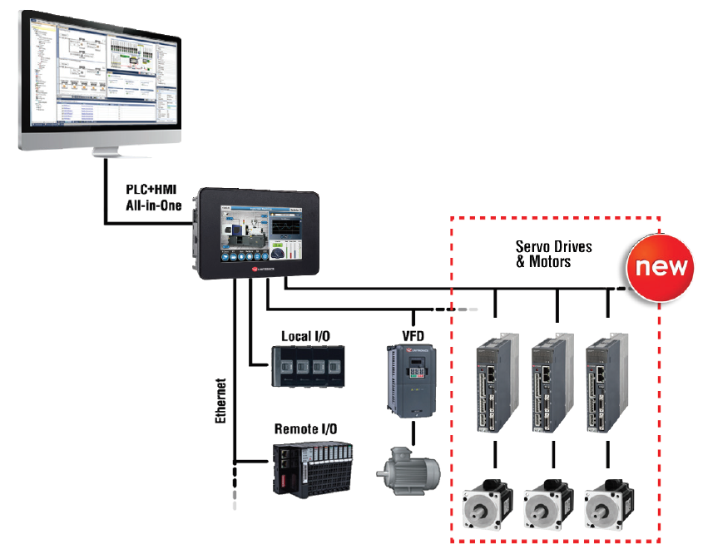
Unitronics System Architecture
Notes:
Number of servo’s per application comparing to number of controllers = revenue
Designed for Unitronics’
vertical solution over CANOpen
EtherCat will be available soon

Slide 7

Common Servo Challenges
Multiple tools required:
  System design
  Servo configuration & tuning
  Communication (fieldbus) implementation
  Logic development
  HMI design
Requires motion-related skill sets:
  Mechanical
  Electrical
  Communication & Control
  System integration
Motion control operation requires many detailed steps

Slide 8
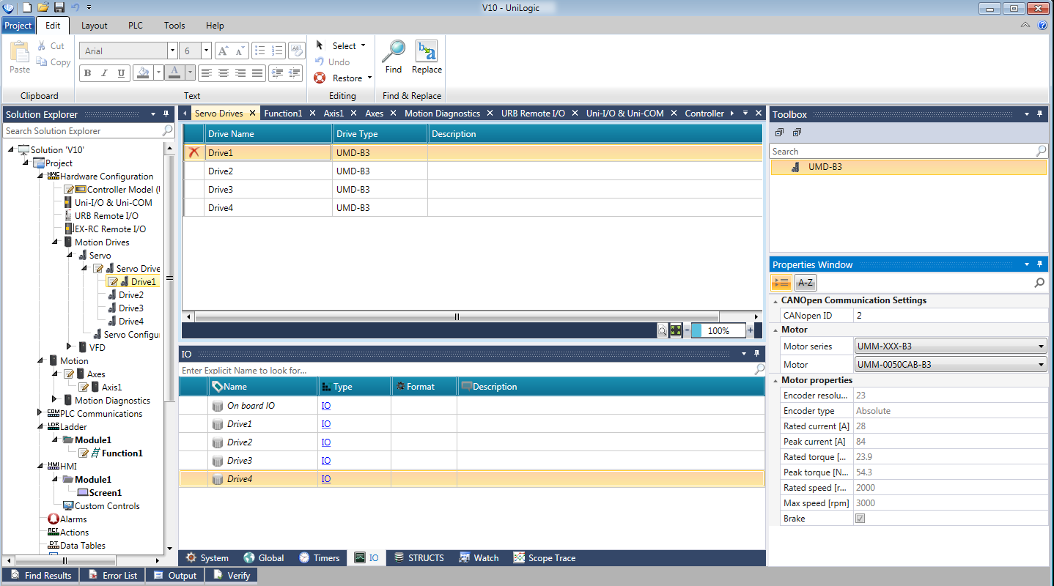

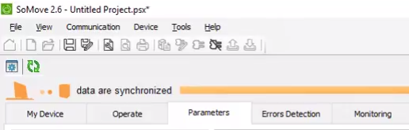
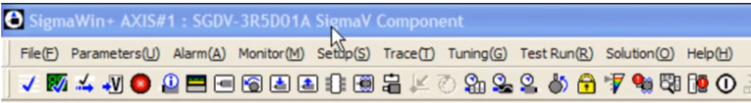
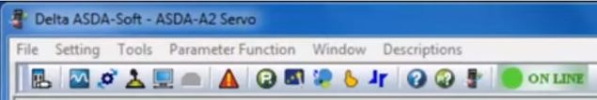
Why Unitronics?
Unitronics - All-in-one Software
Competitors require many different tools

Slide 9
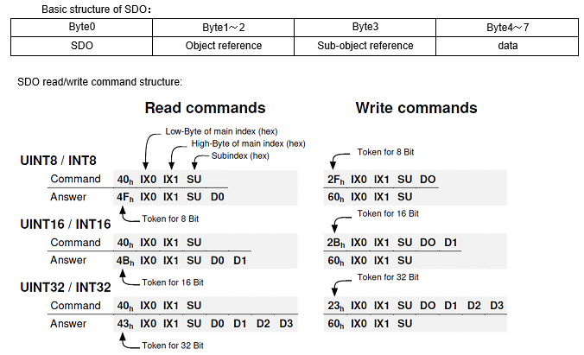
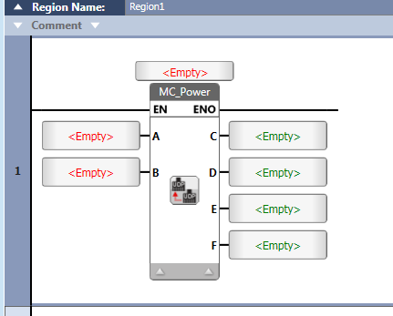
Why Unitronics?
Competitors - Communication Integration
Unitronics - Function Blocks

Slide 10

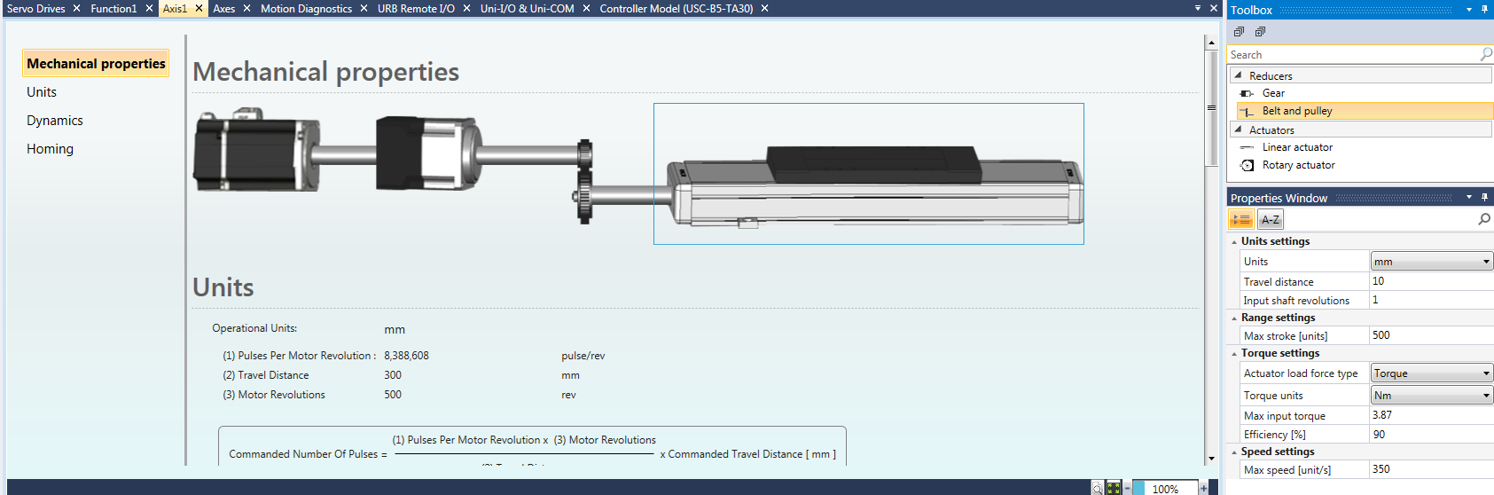
Why Unitronics?
Competitors- Mechanical Calculations
Unitronics - Mechanical Properties Tool
Notes:
Unit conversion (up to 3 actuators)
Controlling the mechanical restrictions and limitations
Minimize errors

Slide 11
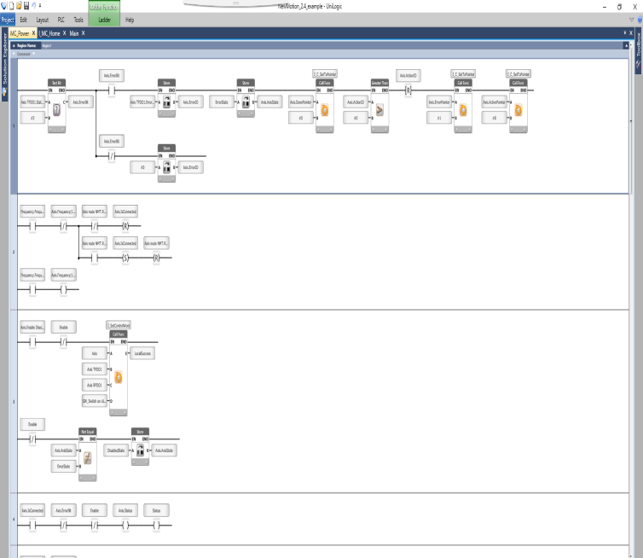
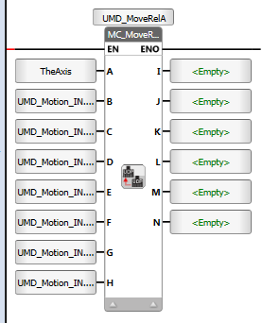
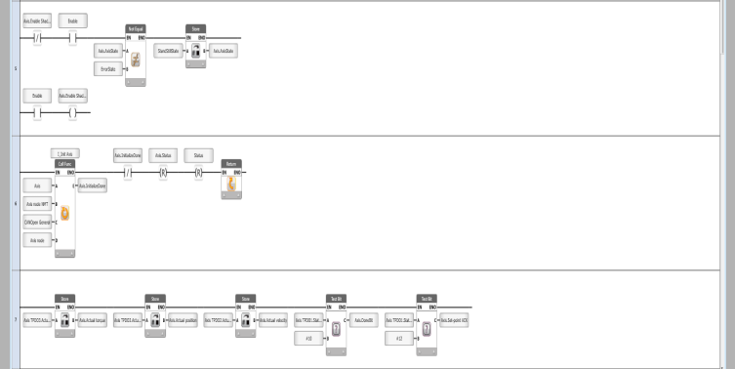
Why Unitronics?
Drag & Drop function blocks - Reduce development time and complexity
PLCopen Based FBs

Slide 12
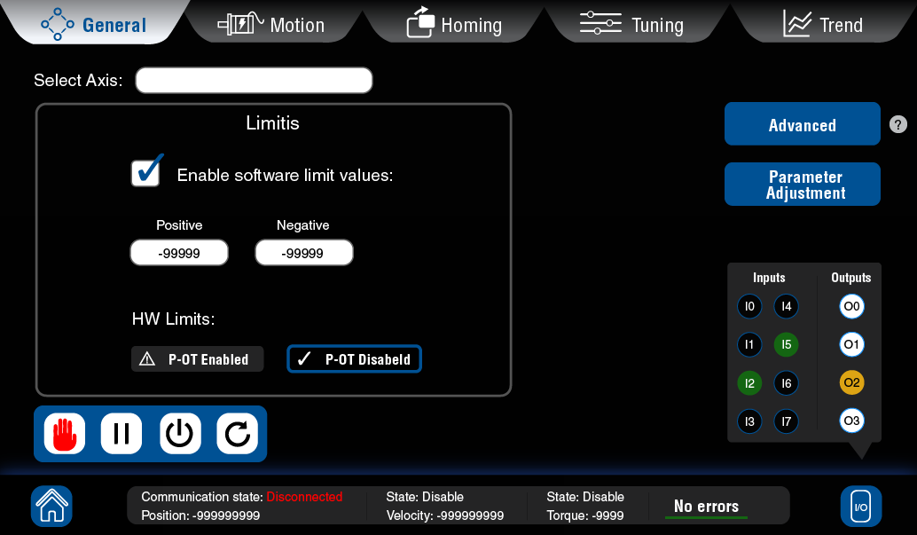
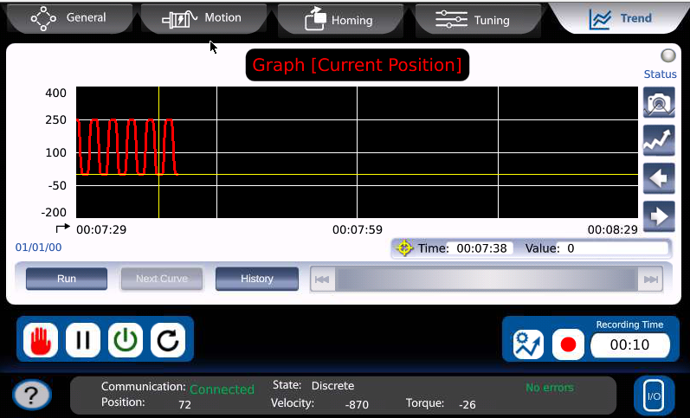
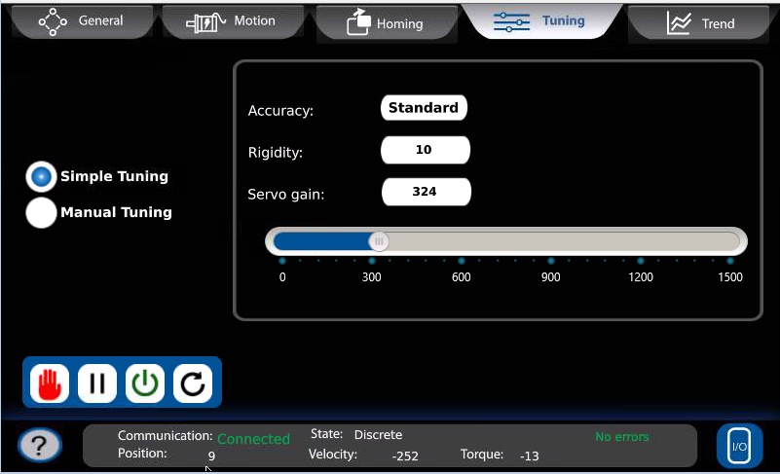
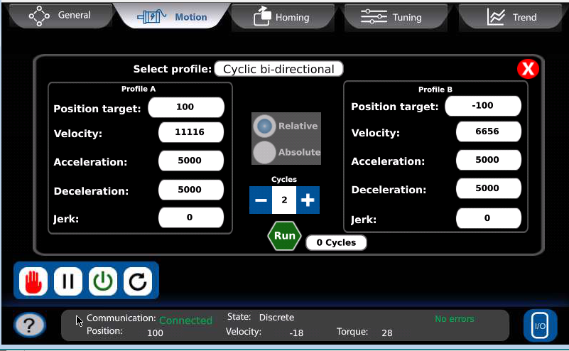
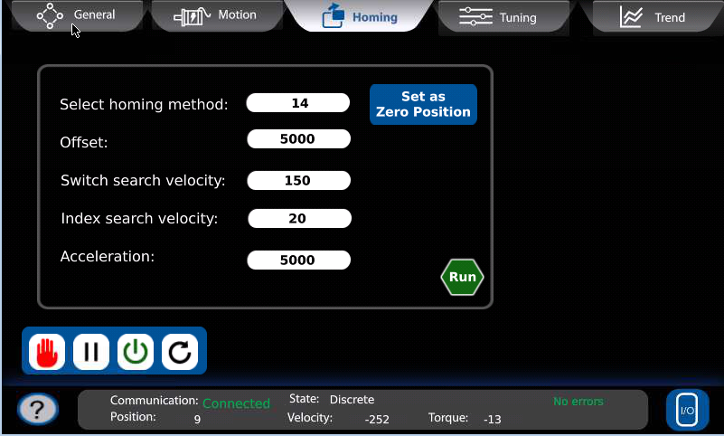
Why Unitronics?
Unitronics - Default HMI Control
Notes:
Set Axis Parameters
Execute Movements
Monitor Axis behavior

Slide 13
Value
Simplifies implementation of motion applications
One unified software environment (Unilogic / Visilogic)
Minimizes complexity, reduces development time
Easy programming via Drag & Drop FBs (PLCopen based)

Slide 14
Target Audience
Primarily Machine Builders
Machine types:
    Up to 8 Axes
    No interpolation required
    Response time – PLC standard –(5 msec typical response time)
    No STO (available in future)

Slide 15

Applications
Targets
Not Currently Targeting
Packaging
Pick & place
Material handling
Conveyors
Clamping
Dosing
Capping
CNC
Robotics
Notes:
No second chance for first impression.
Don’t offer this solution for complex applications

Slide 16

Common Applications
Filling\Dosing
Pick & Place
Indexer + Capping
Assembly line + inspection

Slide 17
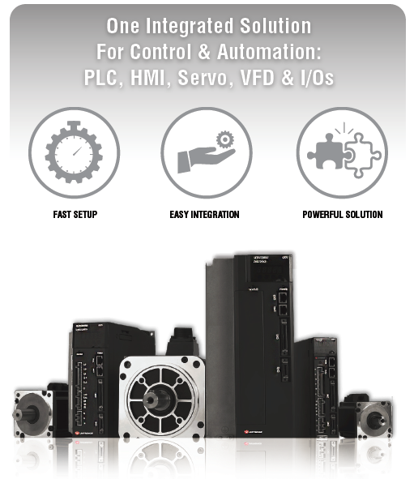
Unitronics Servo Features
One Unified Software Platform
Automatic Communication
Minimize Complexity
Embedded Diagnostic Tools
Motion Control Programming
Wide Range of Servos
Notes:
One Software - for system design, axis configuration, components tuning, and to program it all:
PLC, HMI, Servo, VFD, and I/O
Automatic communication setup: absolutely seamless
Saves Time – short learning curve, plug & play integration
Hiding complexity – configuring only what’s needed

Slide 18
Summary Unitronics Servo Products Benefits
One Integrated Solution
  PLC + HMI
  Servo + accessories
  IOs
  VFDs
Single development environment
Brings an innovative approach to motion control
Reduced Total Cost of Ownership

Slide 19
Questions?

